Slide 1
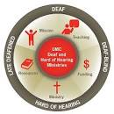
YYatosha Deaf Ministries
A project of
the Tanzania United Methodist Conference
Supported by UM Deaf and Hard of Hearing Committee

Slide 2
YATOSHA
Means “enough”
God always provides “enough”
and
We have had “enough”. No more injustice and lack
The Deaf must have equality and access

Slide 3
Tanzania

Slide 4
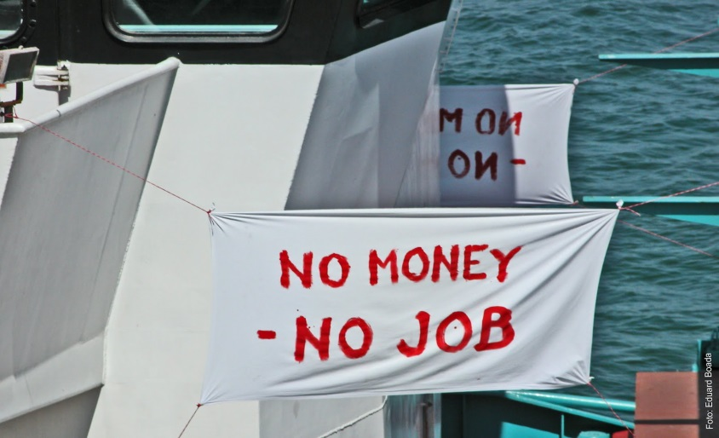
Lots of Deaf people but very few services
Over 500,000 Deaf people
55% are illiterate and have had no schooling
Most unemployed and no vocational skills.

Slide 5
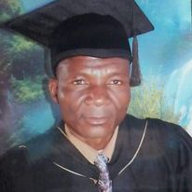
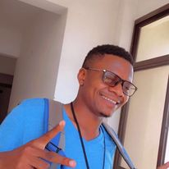
A Bit of Yatosha History
Rev. Levi, first Tanzanian pastor to graduate from Africa University in 2008. Saw Deaf Ministry at Hilltop UMC in Mutare, Zimbabwe, and dreamed of ministry with Deaf people in Tanzania. He returned and was made District Superintendent and General Secretary of the TAC. He died suddenly of pneumonia in 2016 with the dream unrealized.
Nyasinde Pablo, son of Rev. Levi, returned from school and using his father’s password found a folder marked “Deaf Project - Unfinished”. He caught the vision. After finishing college he became the volunteer Youth and Young Adult Education Coordinator for the Tanzania UM conference. With the Deaf Vision he enlisted other young volunteers to develop the Yatosha Deaf Ministries Project in 2020. And the Dream became a growing reality.

Slide 6
THE VISION
Equal access and empowerment of
Deaf people to have full lives –
education, health care, vocational skills, spiritual care and worship,
self-determination, empowerment
A FULL LIFE IN THE COMMUNITY.

Slide 7
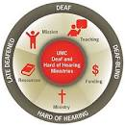
Yatosha
The United Methodist Church
Tanzania Annual Conference
partners
UM Deaf and Hard of Hearing Committee
of the
General Board of Global Ministries

Slide 8
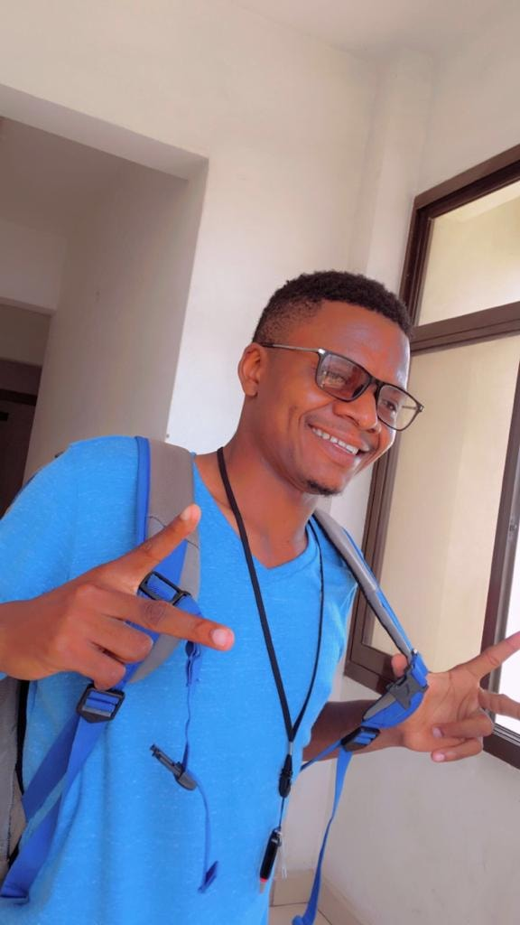
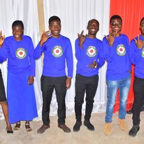
Some of the young adults United Methodist
Yatosha Team members
ALL volunteers
Nyasinde Pablo
Director

Slide 9
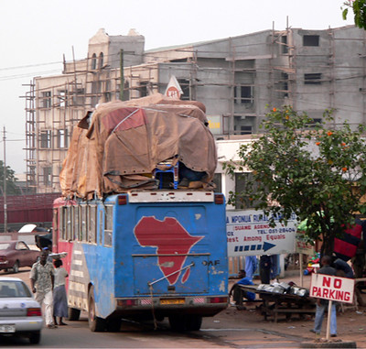
Yatosha
2 locations -16 hours apart by bus.

Slide 10
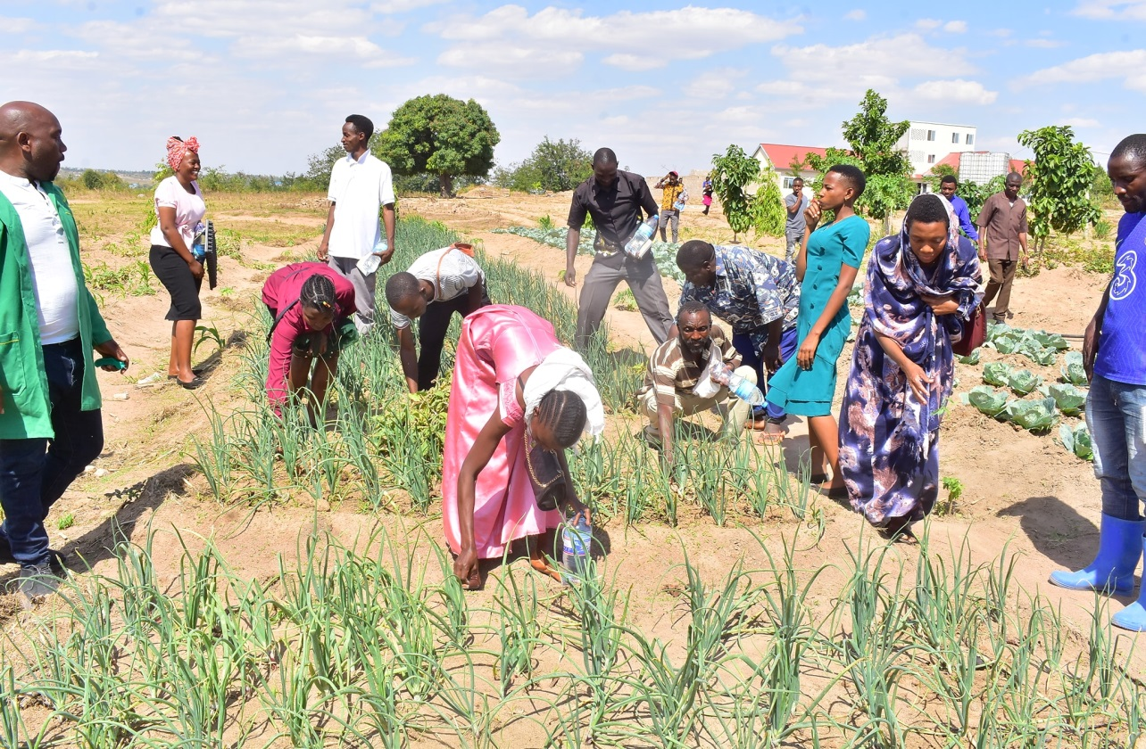
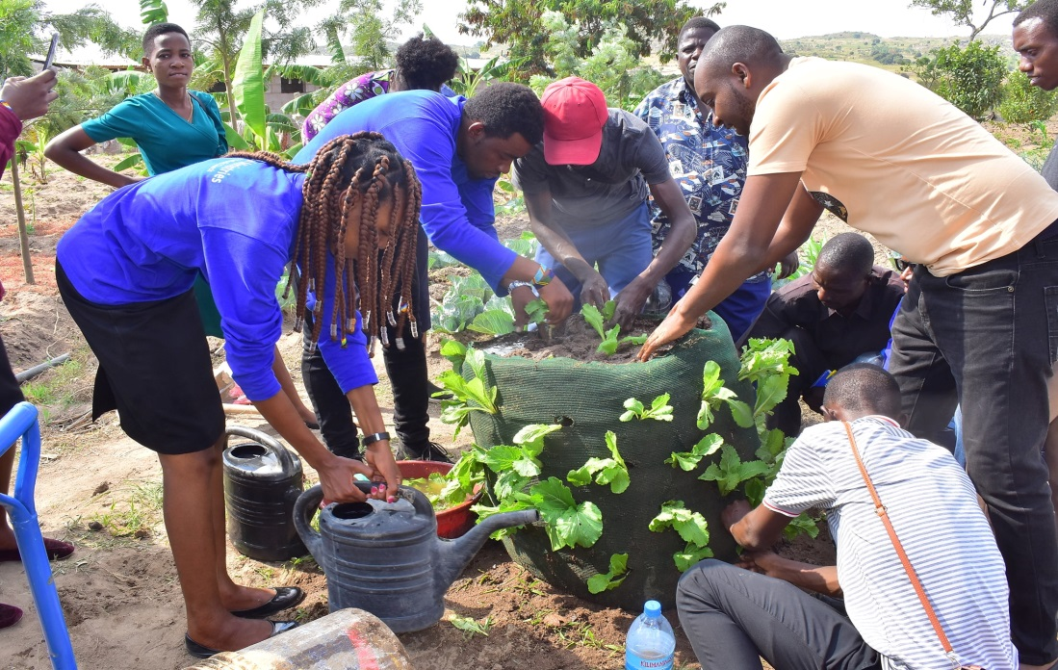
Deaf community
learning
innovative farming techniques
at Yatosha demonstration farm

Slide 11
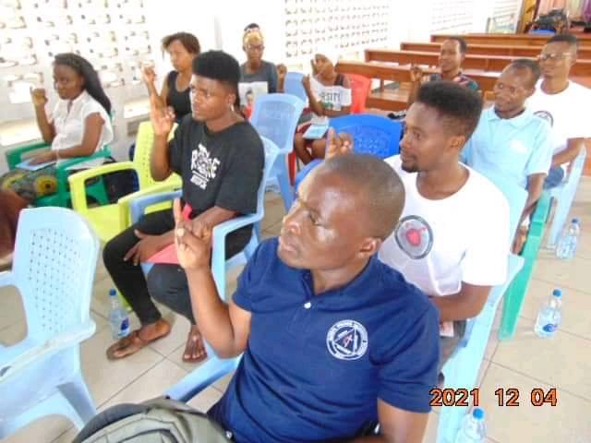
One of the Tanzania Sign Language Classes
You must know the Deaf person’s language to develop a caring, respectful relationship

Slide 12
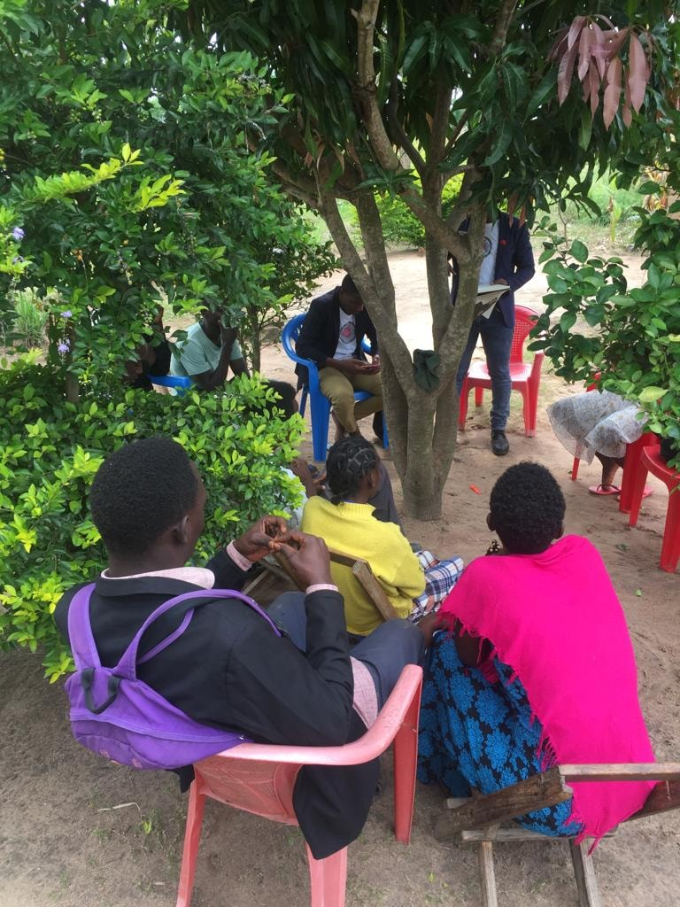
Developing Deaf Community Organization
Empowerment!

Slide 13
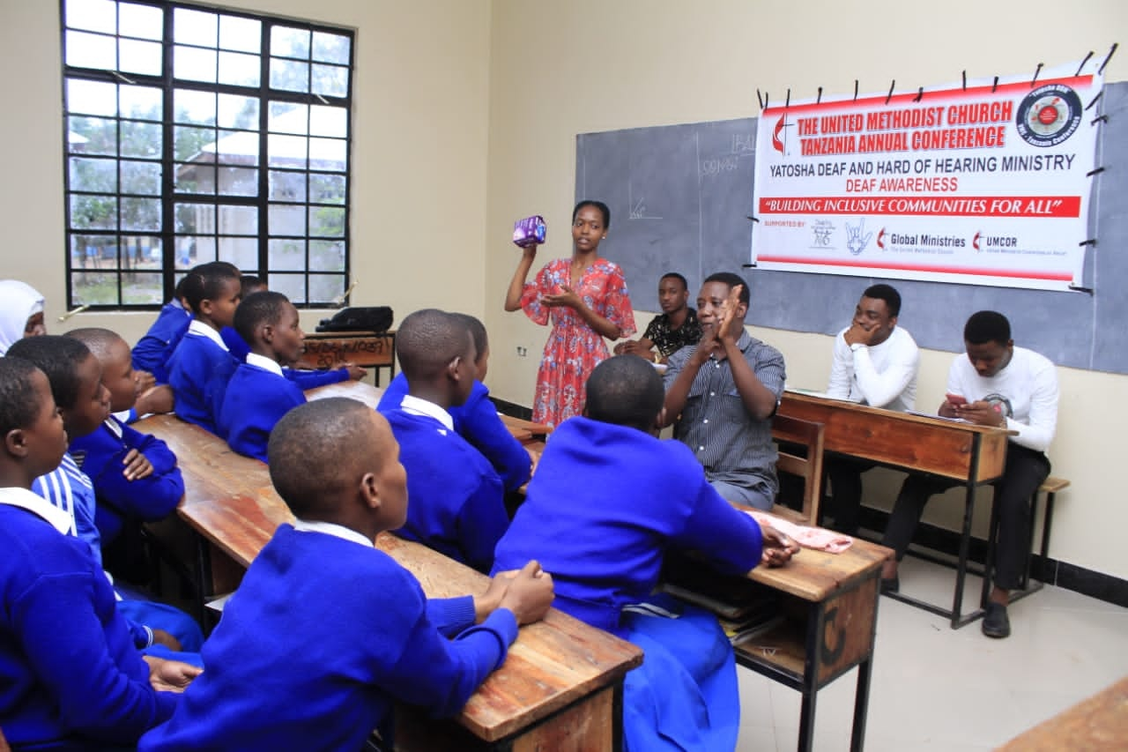
Health education with Deaf students at local school

Slide 14
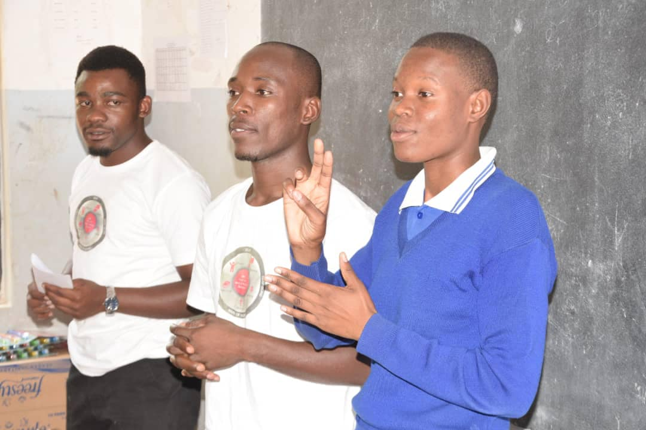
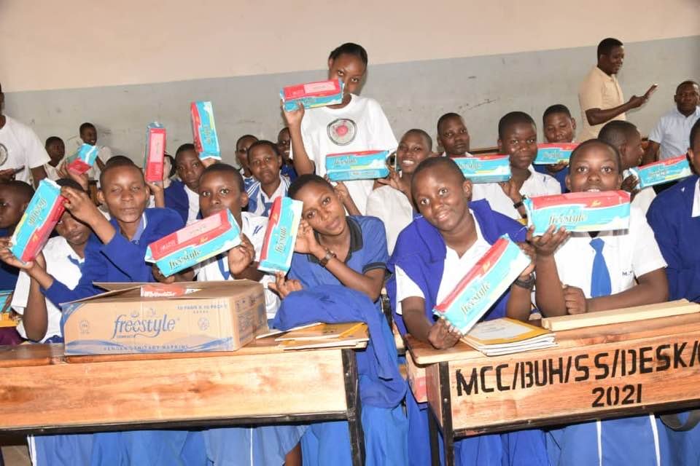
At the Deaf class –
religious education fellowship and
FUN and GIFTS !

Slide 15
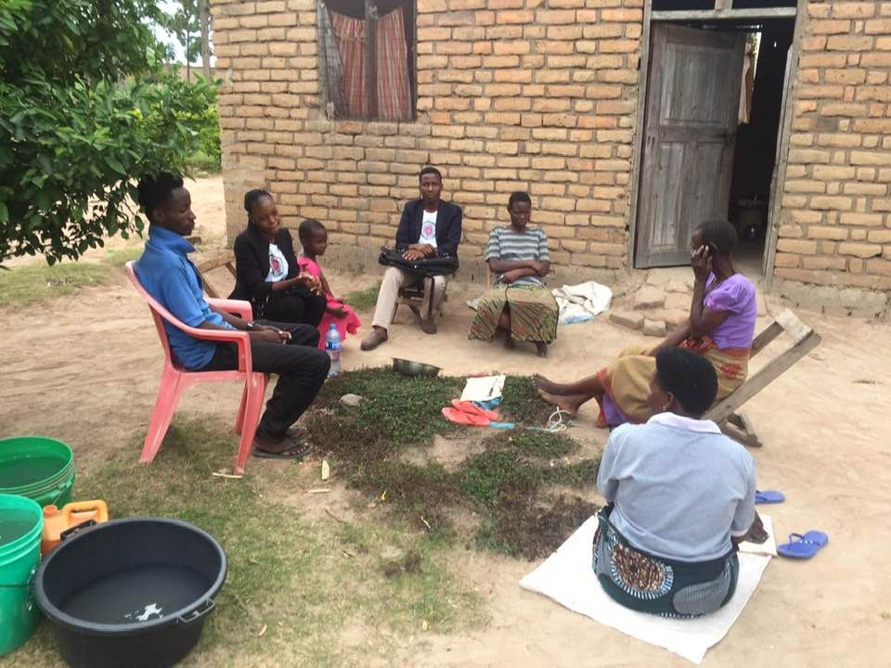
Home visitation and Evangelism

Slide 16
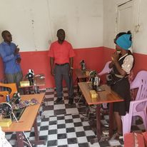
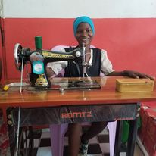
Income generating sewing project
Next welding….

Slide 17
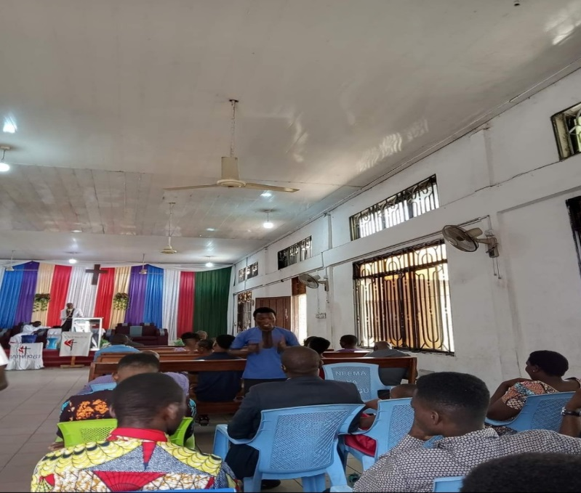
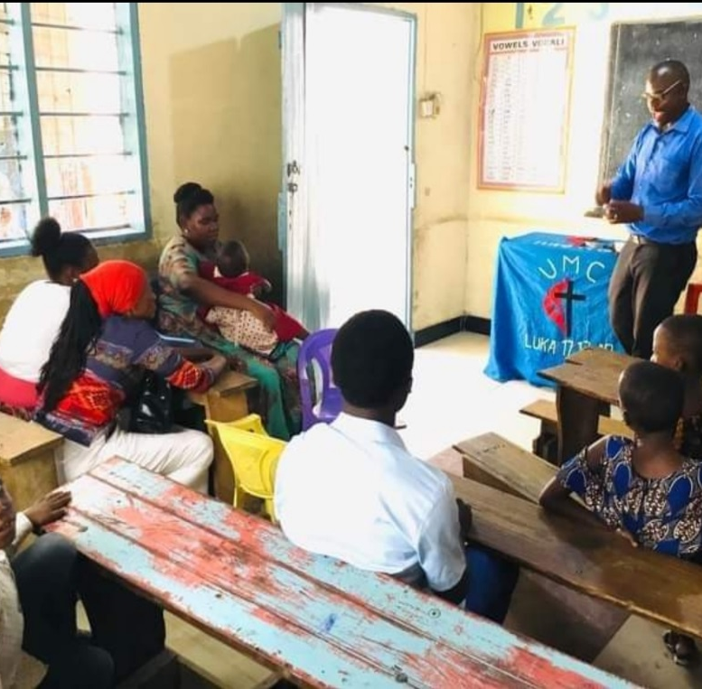
Development of Deaf Worship
Difficult for Deaf to see interpreter
Message doesn’t fit Deaf experience
Deaf just observe worship
Service not in their heart language
Deaf not empowered for leadership
Person with key often doesn’t unlock
Deaf can’t get into room
Room floods when raining
Must worship outside in hot sun
Church is 2 hour bus ride from homes
MOVE

Slide 18
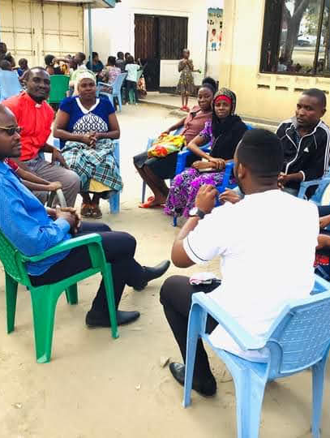
Deaf and hearing church leaders and D.S. meet
Deaf explain their worship needs
Supportive DS & church leaders
Deaf pastor offers land
Near home of Deaf people
Deaf church meets in new place
BUILD!

Slide 19
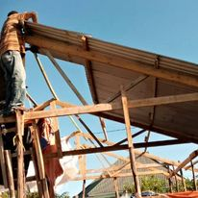
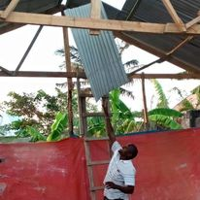
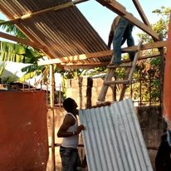
Deaf crew builds the Deaf church

Slide 20
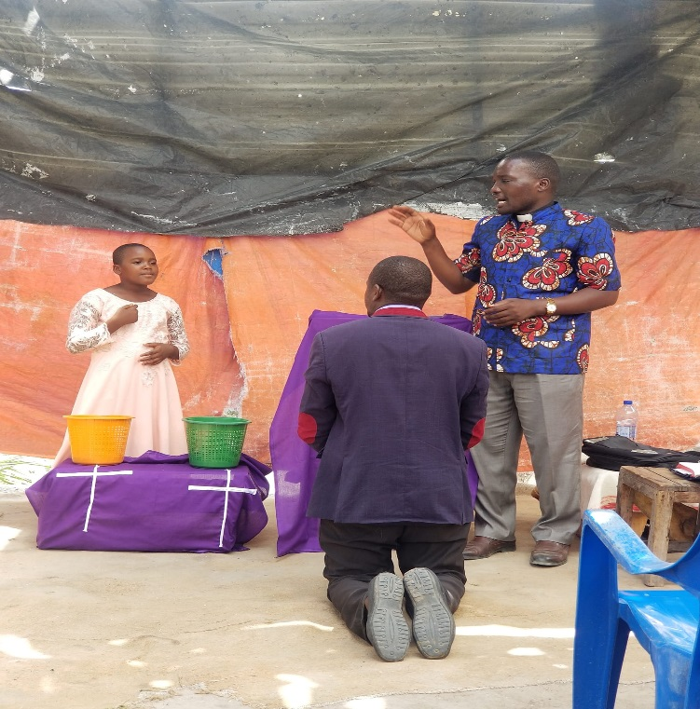
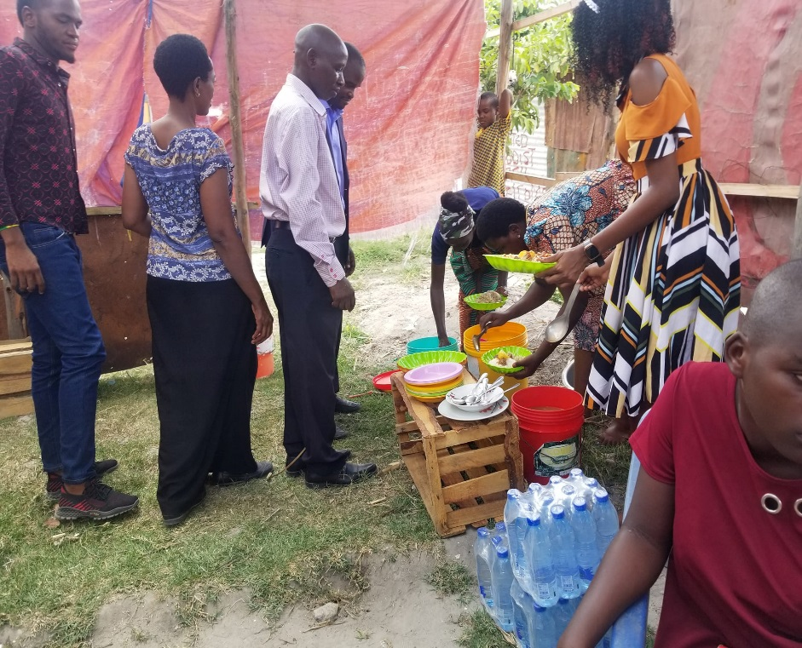
Deaf Awareness Worship Service
October 15, 2023
DS Isaka installs Pastor Isaya as leader of
First Deaf UMC Viwege
Deaf church and nearby hearing church celebrate at Deaf church on road now called “Deaf Street

Slide 21
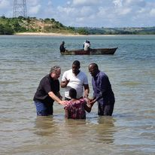
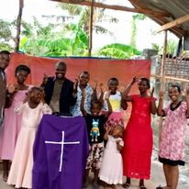
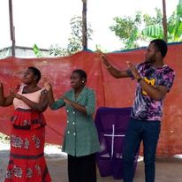
Christian Greetings from First Deaf UMC Tanzania
Deaf church choir signs to the beat of the drum
4 Deaf baptized by Rev. Tom Hudspeth of the UM-DHM Deaf mission team

Slide 22
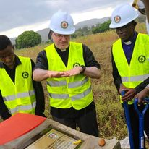
The next big dream… Education !
for 300 Deaf children in an area
who now have no school
Dedicating the land for
Yatosha Deaf School

Slide 23
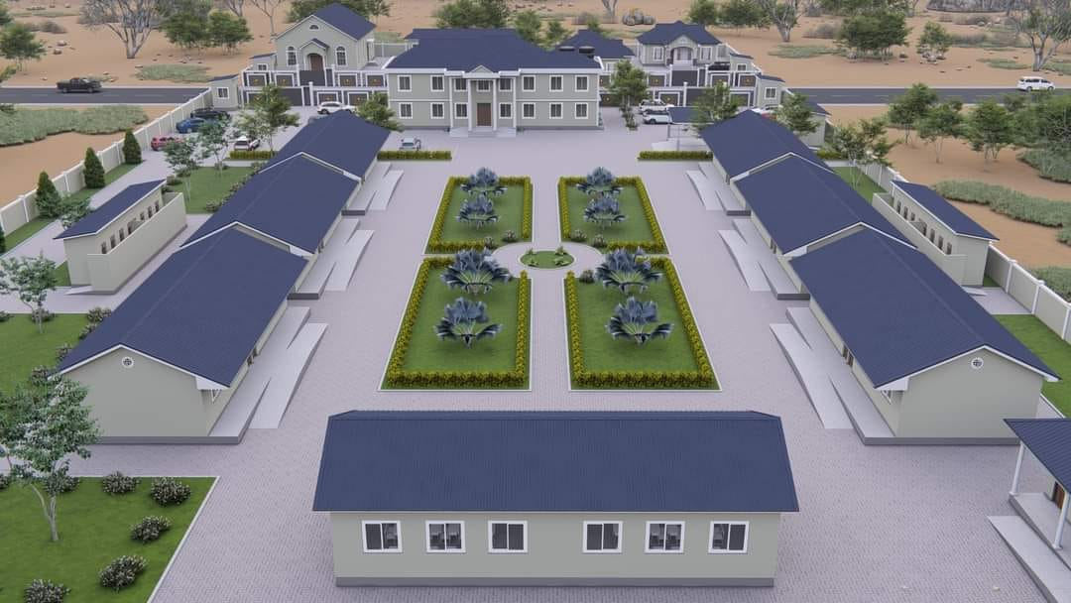
Yatosha Deaf School in Mwanza, Tanzania
(Architect’s proposal)
Proposed residential Deaf school for 300 students in area with NO Deaf education.
55% of Deaf people is Tanzania are illiterate.
Tanzania curriculum with vocational and computer classes in sign language.
6 ½ acres purchased. Need for $625,000 over the next 4 years to build

Slide 24
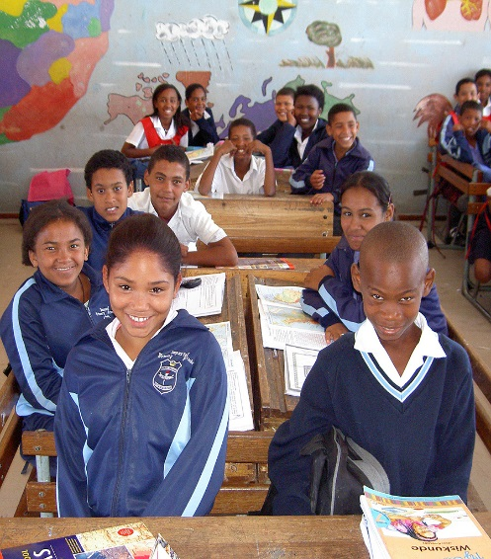
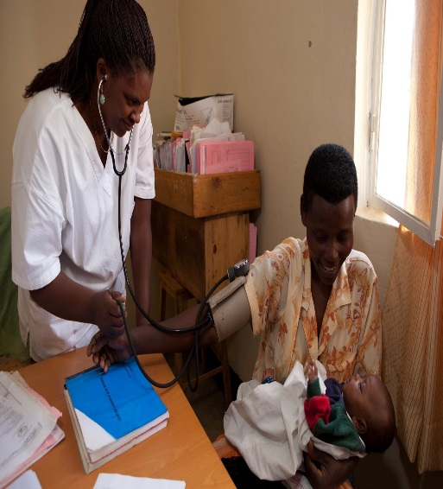
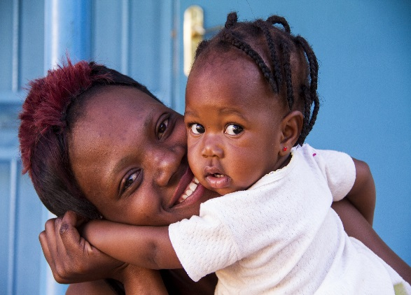
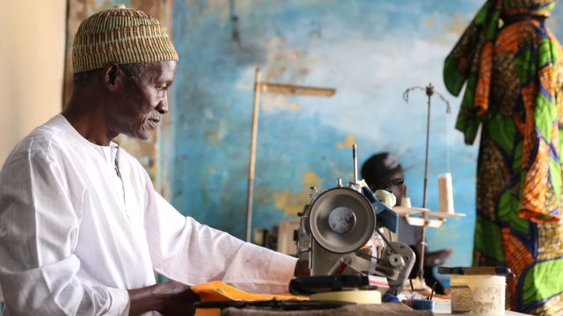
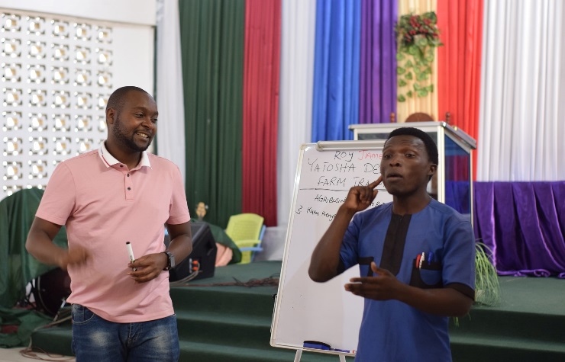
“The limits of my language
mean the limits of my world.”
— Ludwig Wittgenstein.
Education means
health
school
family
spiritual growth
jobs

Slide 25
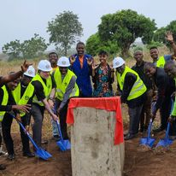
Will your church be one of the 100 UMC-related churches meeting the challenge starting in 2024 to pledge $6000 over a 4 year period ($1500 a year/$125 a month) to build
the Yatosha Deaf School?

Slide 26
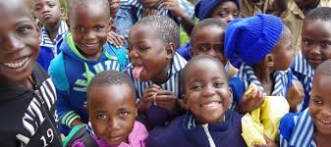
Dreams really can come true
*Give to the United Methodist Advance #982562
https://umcmission.org/advance-project/982562/
*Then contact Rev. Tom Hudspeth at thudspeth@llumc.org
to direct your gift to Yatosha Deaf School
*Encourage your church and conference to make a commitment for ongoing support.
Together we can make miracles happen!

