Slide 1
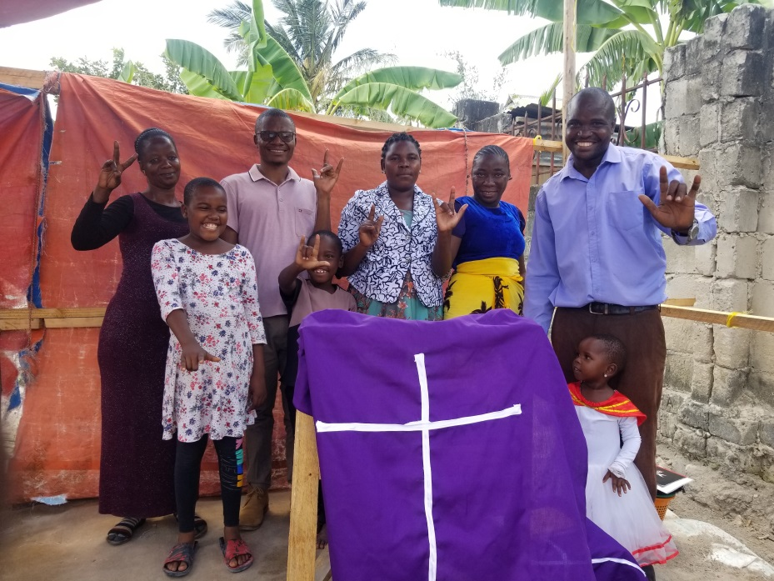
Building a Deaf Church
Tanzania United Methodist Ministry

Slide 2
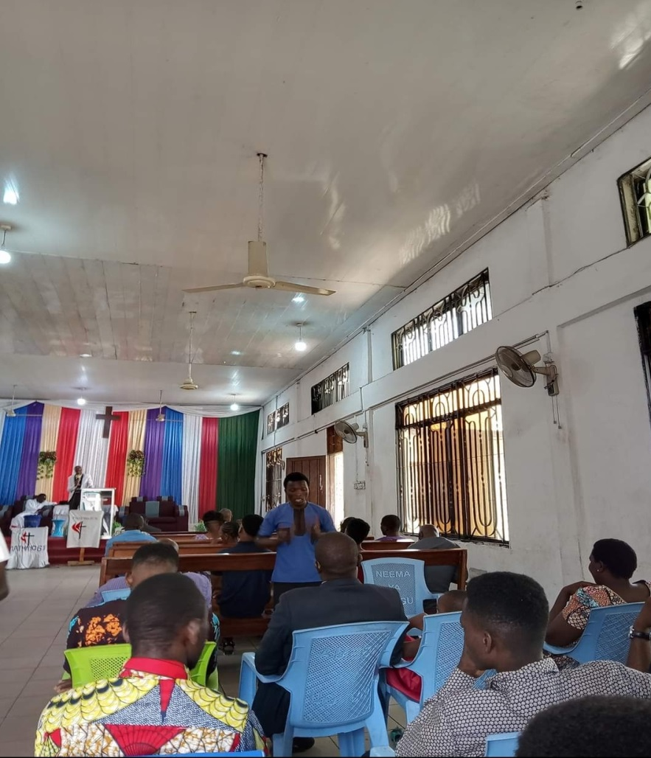
Deaf people worship with hearing church
Deaf can’t see interpreter
Message doesn’t fit Deaf experience
Deaf just observe worship
Service not in their heart language
Deaf not empowered for leadership

Slide 3
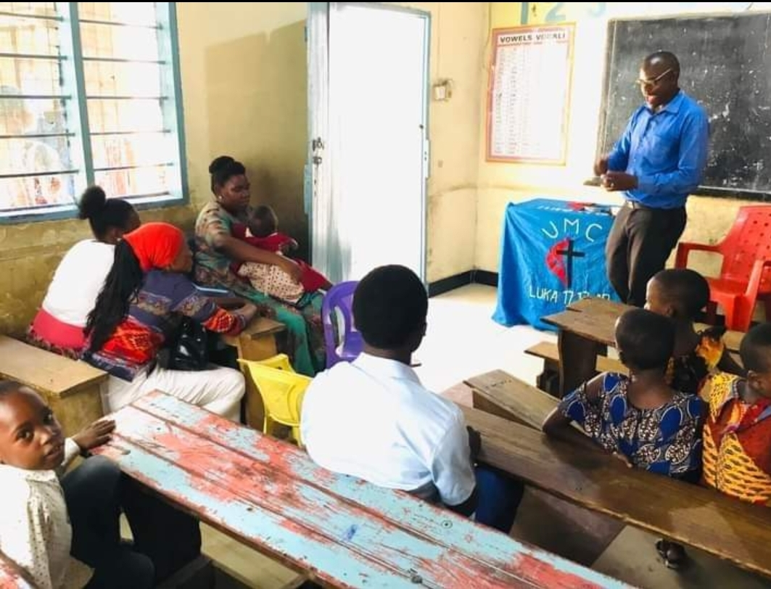
Deaf worship in classroom with Deaf pastor
Person with key often doesn’t unlock
Deaf can’t get into room
Room floods when raining
Must worship outside in hot sun
Church is 2 hour bus ride from homes

Slide 4
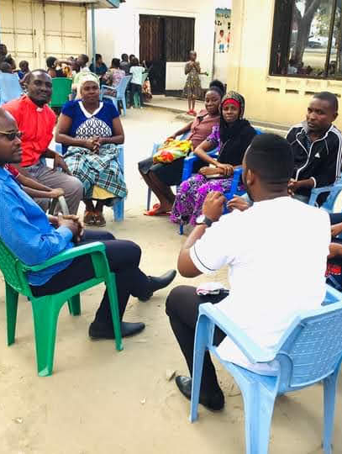
Deaf and hearing church leaders and D.S. meet
Deaf explain their worship needs
Supportive DS & church leaders
Deaf pastor offers land
Near home of Deaf people
Deaf church meets in new place

Slide 5
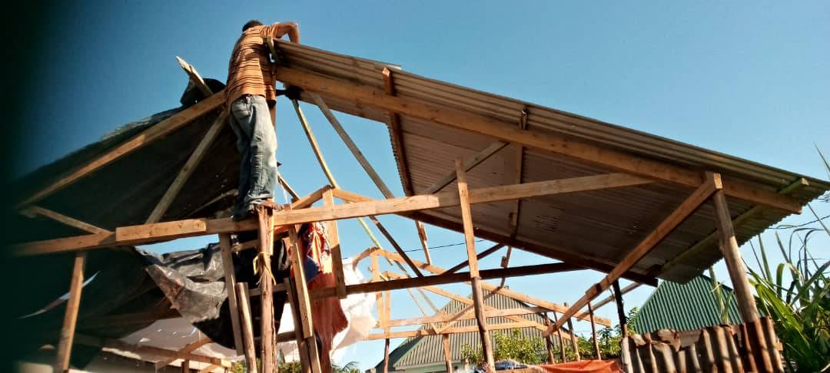
Deaf carpenter and Deaf crew build the Deaf church

Slide 6
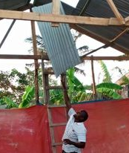
Shiny tin roof and red felt walls

Slide 7
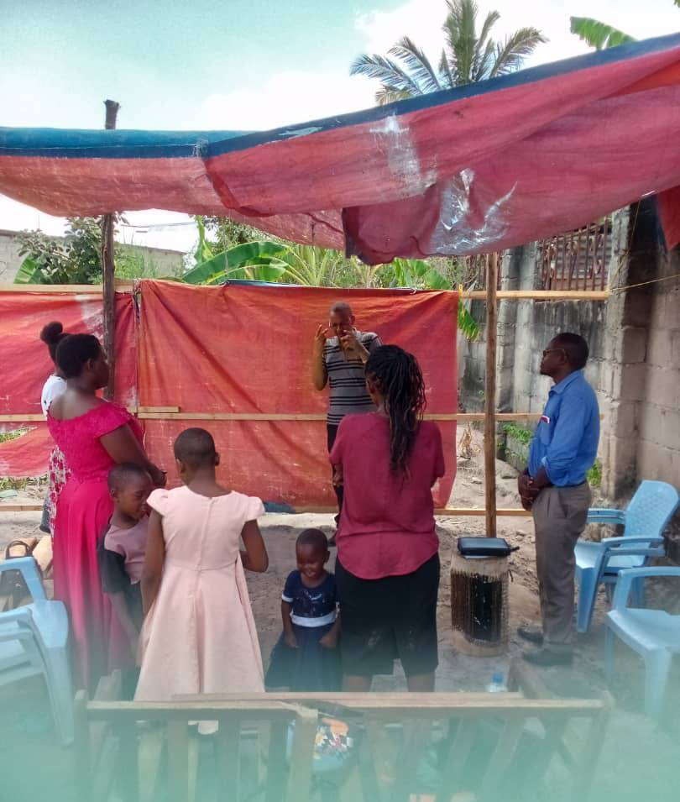
Sunday worship at Deaf Church

Slide 8
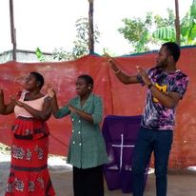
Deaf church choir signs to the beat of the drum

Slide 9
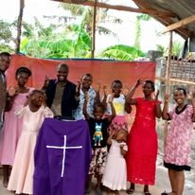
Christian greetings from the Deaf worshipers in Tanzania

Slide 10
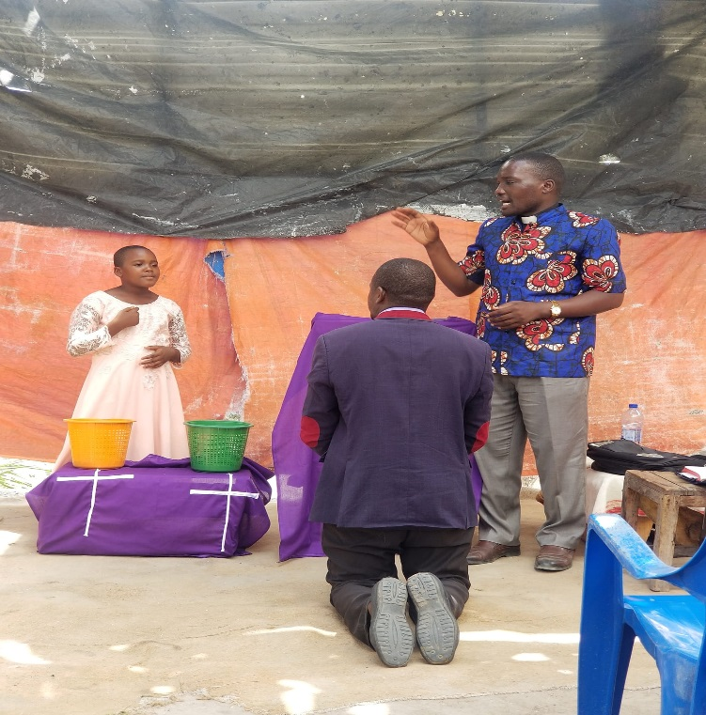
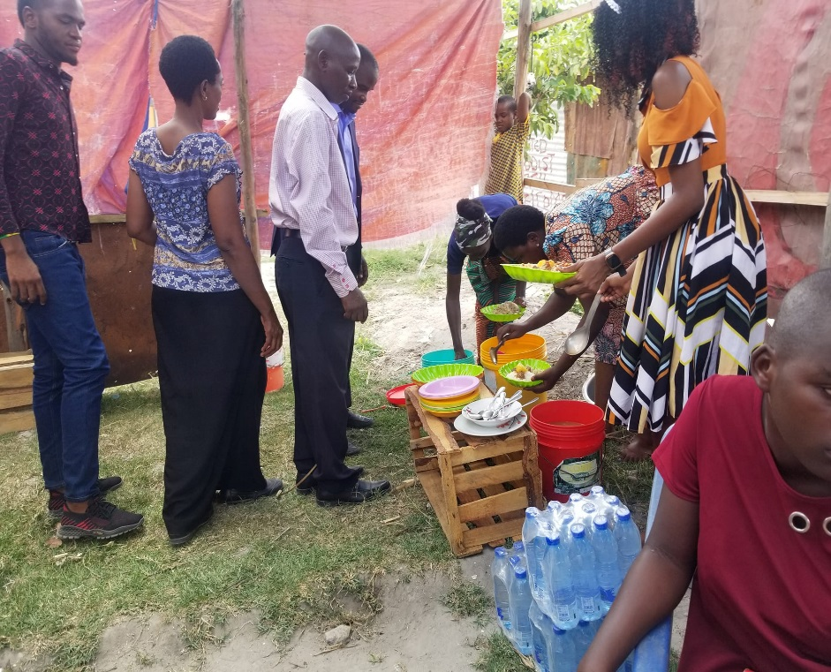
Deaf Awareness Worship Service
October 15, 2023
DS Isaka installs Pastor Isaya as leader of
First Deaf UMC Viwege
Deaf church and nearby hearing church celebrate at Deaf church on road now called “Deaf Street”

Slide 11
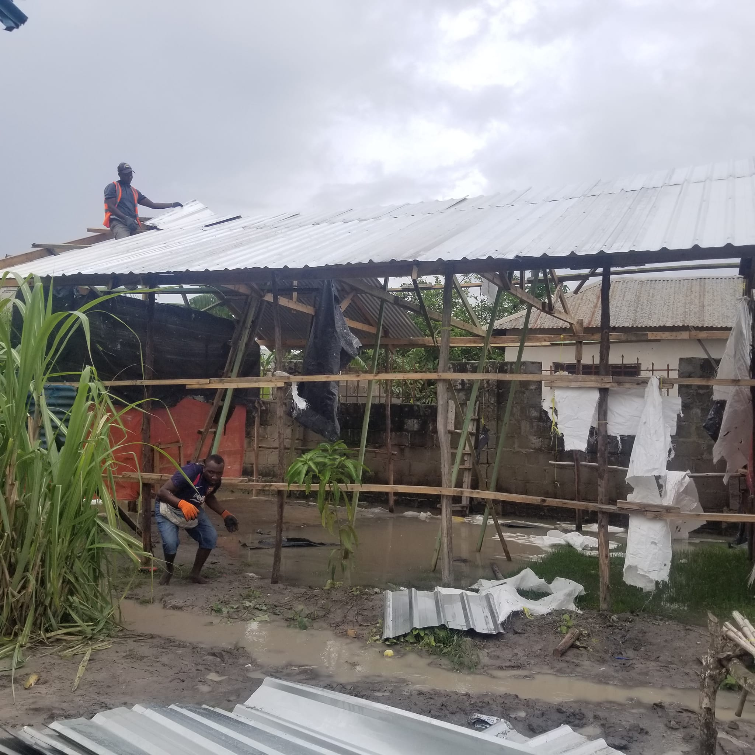
Rushing to build before the rains come

Slide 12
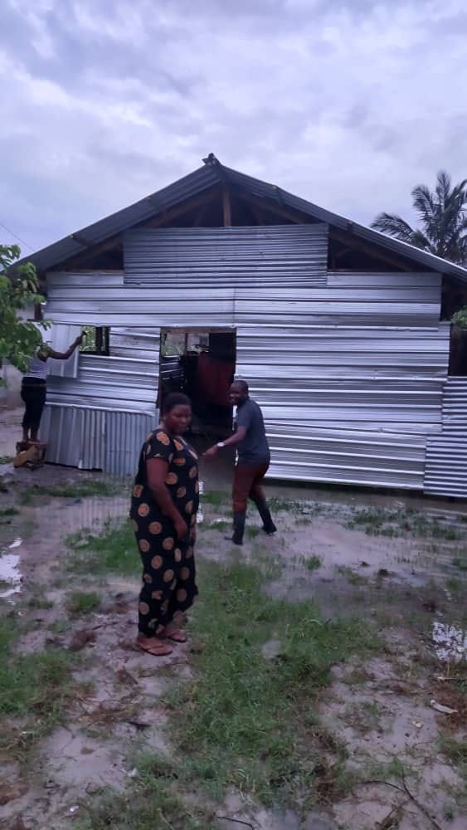
The Walls are Up
BUT
The torrential downpours of the rainy season and
El Nino
have flooded the church and drainage channels and a foundation must be constructed to protect the building and sand put in to create a floor.

Slide 13
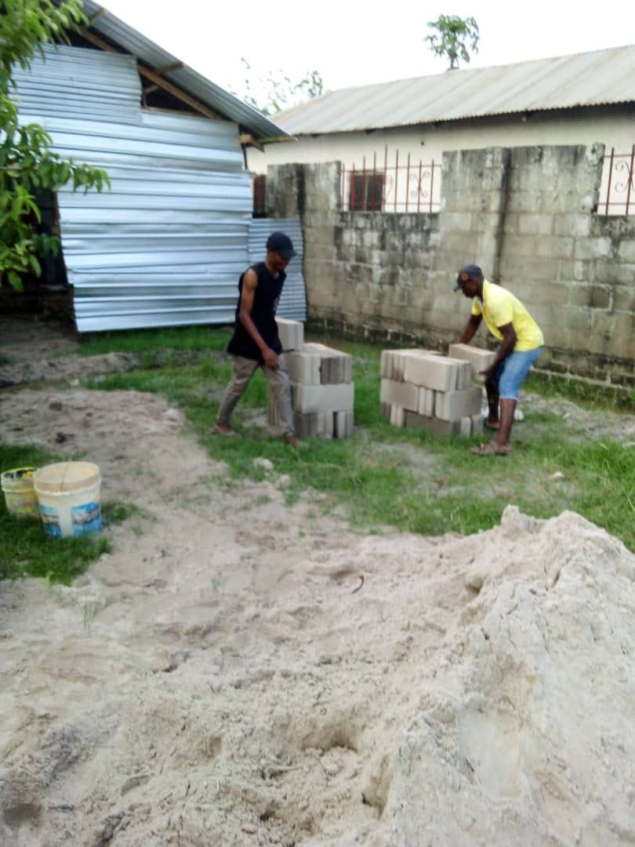
A break in the rains
Rushing to build a foundation to protect the church from flooding.

Slide 14
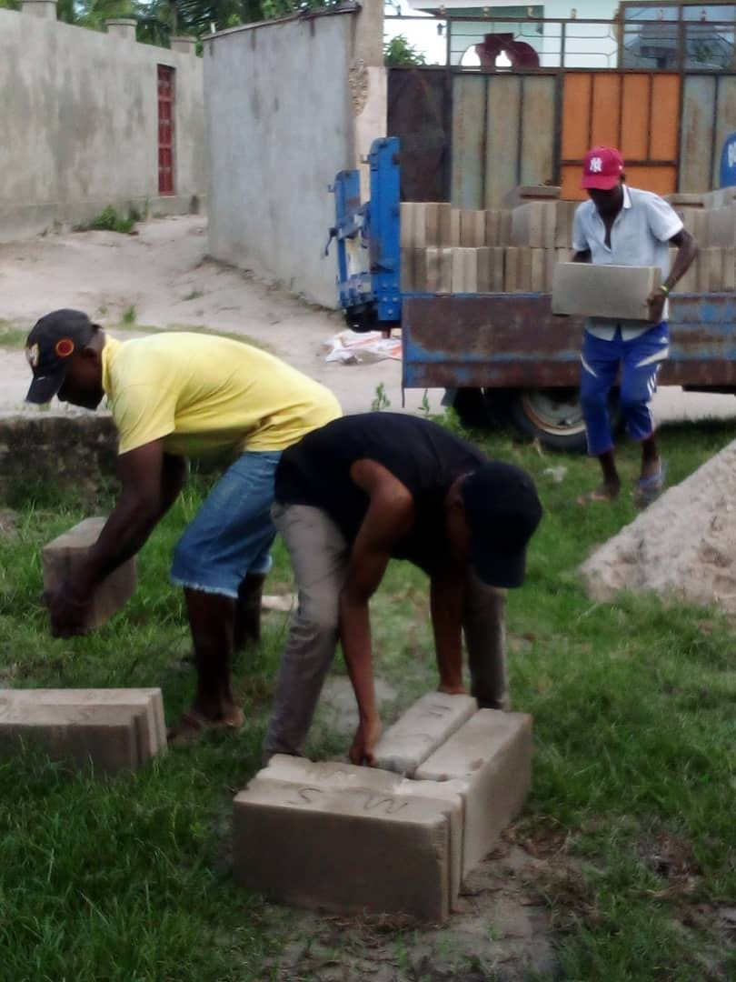
Please help
the building to
Continue . . . . . .

Slide 15
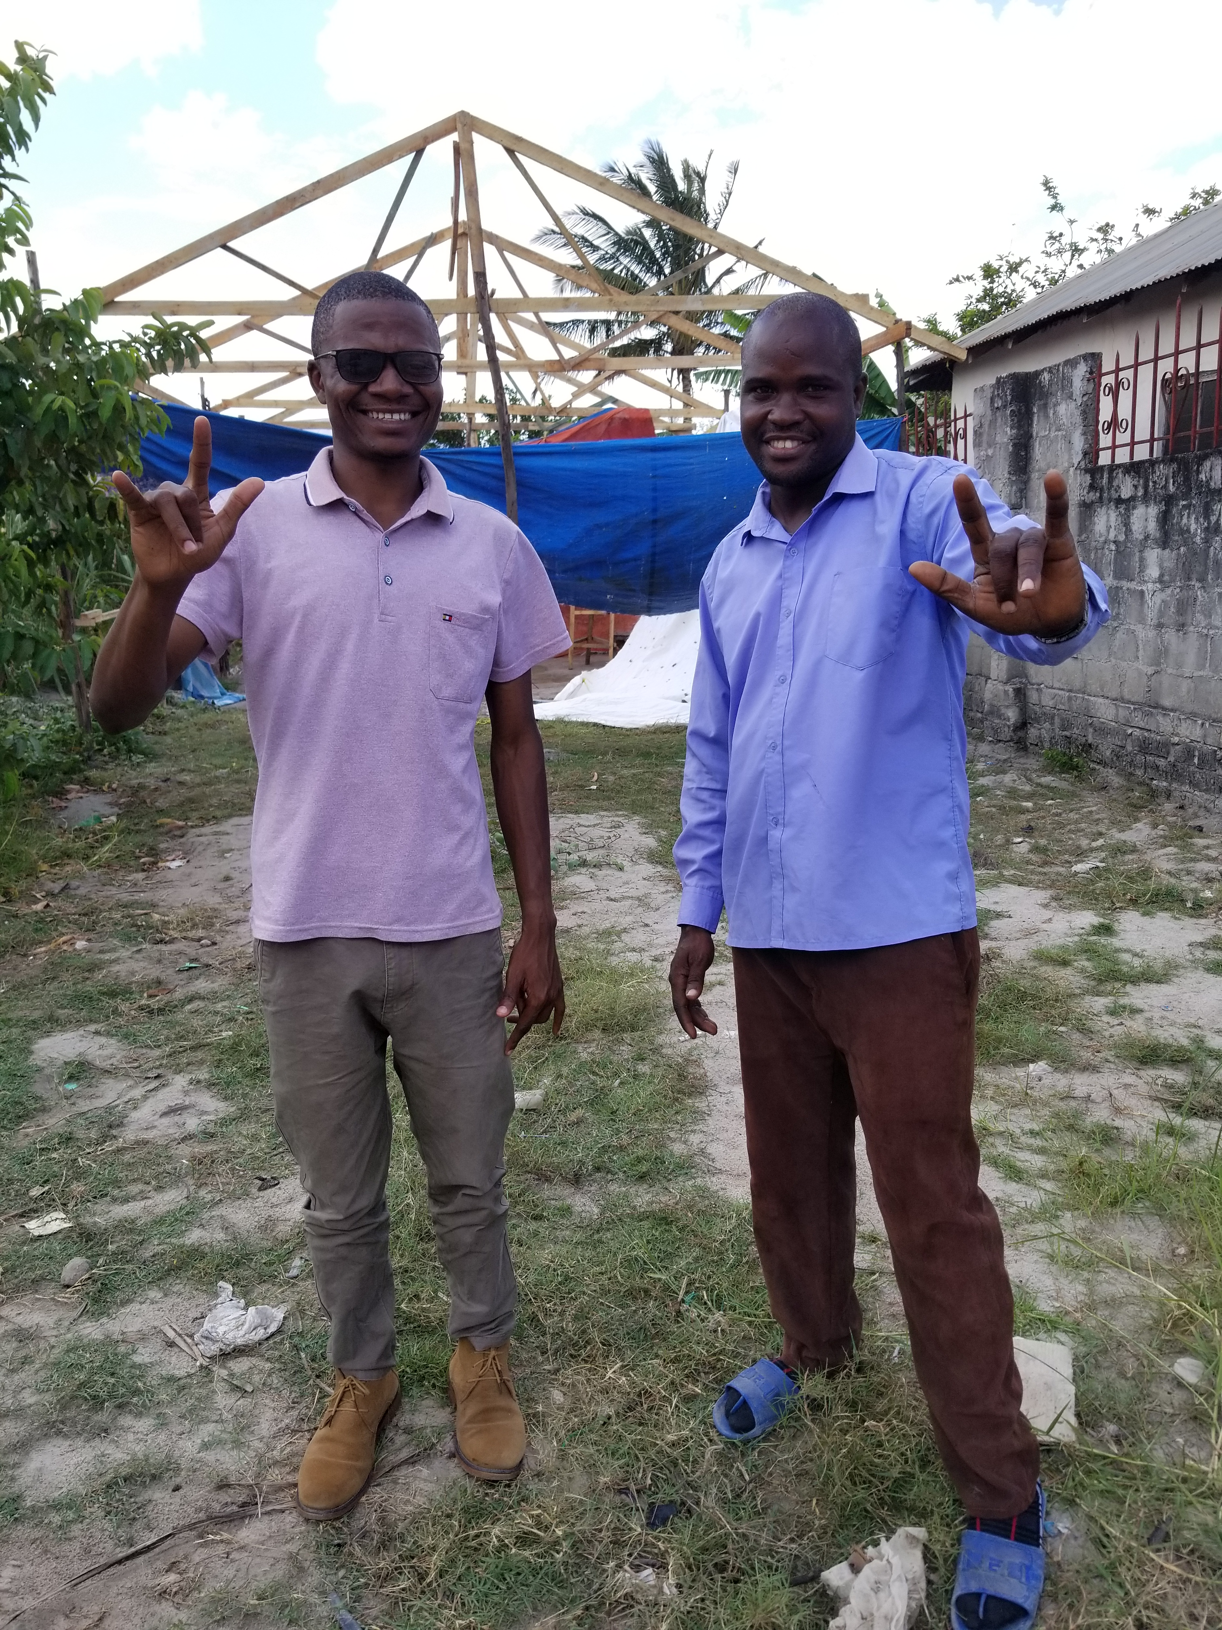
Thanks and I Love You
from
Nyasinde Mwamba Isaya Mwiti
Director, Yatosha Deaf Project Deaf Pastor First Deaf UMC

